Slide 1
Smart Trolley with Automated Billing using RFID
Presented by:
Anshu Poswalia
Ishita Shetty
Saachi Mogra
Riya Gharat

Slide 2
CONTENTS
Introduction
Components
Block Diagram
Circuit Diagram
Methodology
Advantages
Disadvantages / Limitations
Future Scope
Conclusion

Slide 3
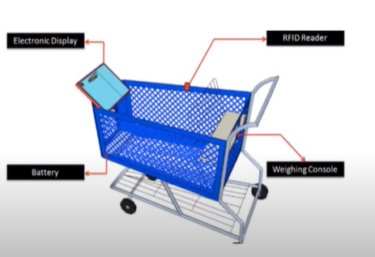
Introduction
Shopping is simple but the huge amount of rush plus cashier preparing the bill with barcode scanner is too time consuming and results in long ques.
To make this complex process a simple one we format a smart trolley.
This innovative project consists of an automated billing system which can be placed within the shopping trolley.
In the billing process the shop keeper scans the barcode of each and every product and it also takes a lot of time.
To make this complex process a simple one we format a smart trolley. This clever trolley consists of an RFID reader which reads the products with the aid of capacity of RFID tag.
In this system, we will save time of customers and manpower required in mall.

Slide 4
COMPONENTS
RFID Module & Cards
Arduino Nano
LCD Display
Crystal Oscillator
Resistors
Switch
Push Buttons
Cables and Connectors
LED

Slide 5
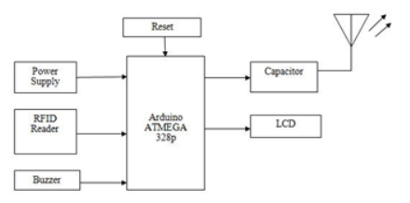

BLOCK DIAGRAM
Reset
Power Supply
Arduino Nano
RFID Reader
LCD
Buzzer

Slide 6
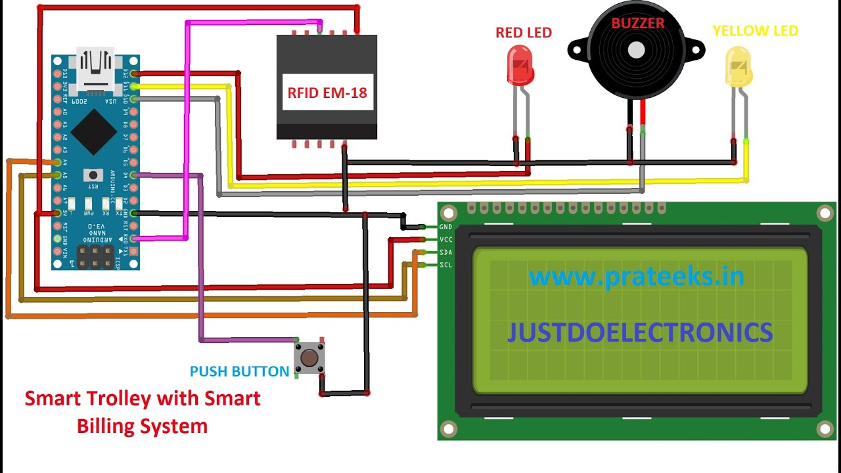
CIRCUIT DIAGRAM

Slide 7
Code
//import the libraries
#include <Arduino.h>
#include <LiquidCrystal_I2C.h>
#include <Wire.h>
//initialise 16*2 lcd
LiquidCrystal_I2C lcd(0x27, 16, 2);
//declaring variables
char input[12];
int count = 0;
int a;
int p1=0,p2=0,p3=0,p4=0;
int c1=0,c2=0,c3=0,c4=0;
double total = 0;
int count_prod = 0;
void setup ()
{
//Pin direction
pinMode(3, INPUT_PULLUP); //Push Switch
pinMode(4, OUTPUT); //RED LED
pinMode(5, OUTPUT); //BUZZER
pinMode(6, OUTPUT); //GREEN LED
// Initialization
Serial.begin(9600);
//lcd.begin();
lcd.init();
lcd.backlight();
lcd.setCursor(0, 0);
lcd.print(" SMART ");
delay (2000);
lcd.setCursor(0, 1);
lcd.print(" SHOPPING CART! ");
delay (2000);
lcd.clear();
lcd.setCursor(0, 0);
lcd.print(" WELCOME TO ");
lcd.setCursor(0, 1);
lcd.print(" MPSTME MALL! ");

Slide 8
Code
}
void loop()
{
count = 0;
while (Serial.available() && count < 12)
{
input[count] = Serial.read();
delay(5);
}
int a=digitalRead(3);
if ((strncmp(input, "4000350ABAC5", 12) == 0) && (a == 1))
{
lcd.setCursor(0, 0);
lcd.print("Butter Added");
lcd.setCursor(0, 1);
lcd.print("Price(Rm):4.00");
digitalWrite(4,HIGH);
digitalWrite(5,LOW);
digitalWrite(6,HIGH);
delay(2000);
total = total + 4.00;
count_prod++;
digitalWrite(4,LOW);
digitalWrite(5,HIGH);
digitalWrite(6,LOW);
}
else if ((strncmp(input, "4000350ABAC5", 12) == 0) && (a == 0))
{
if(p1>0)
{
lcd.clear();
lcd.setCursor(0, 0);
lcd.print("Butter Removed!!!");
digitalWrite(4,HIGH);
digitalWrite(5,LOW);
digitalWrite(6,HIGH);
delay(2000);
total = total - 4.00;
lcd.clear();
digitalWrite(4,LOW);
digitalWrite(5,HIGH);
digitalWrite(6,LOW);
}

Slide 9
Code
lcd.clear();
lcd.setCursor(0, 0);
lcd.print("Total Price :-");
lcd.setCursor(0, 1);
lcd.print(total);
delay(5000);
lcd.clear();
lcd.setCursor(0, 0);
lcd.print(" THANKS FOR ");
lcd.setCursor(0, 1);
lcd.print(" VISITING! ");
}
}
}
else
{
lcd.clear();
lcd.setCursor(0, 0);
lcd.print("Not in cart!!!");
digitalWrite(4,HIGH);
digitalWrite(5,LOW);
digitalWrite(6,HIGH);
delay(2000);
digitalWrite(4,LOW);
digitalWrite(5,HIGH);
digitalWrite(6,LOW);
lcd.clear();
}
}
}
{

Slide 10
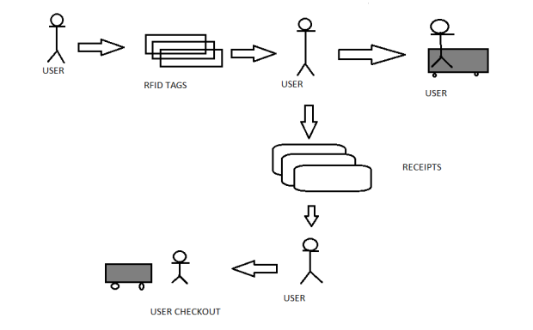
METHODOLOGY
1. All Items in the store are equipped with RFID Tags.
2. RFID Scanner read the product details with the help of Arduino Nano and displays on the LCD.
3. As the items keep adding, the details are displayed and total quantity and amount gets calculated.
4. If any product is required to be removed then the delete button can be used.
5. RFID tags uses wireless communication which is not necessarily line of sight. Hence, it suits the best for this project.

Slide 11
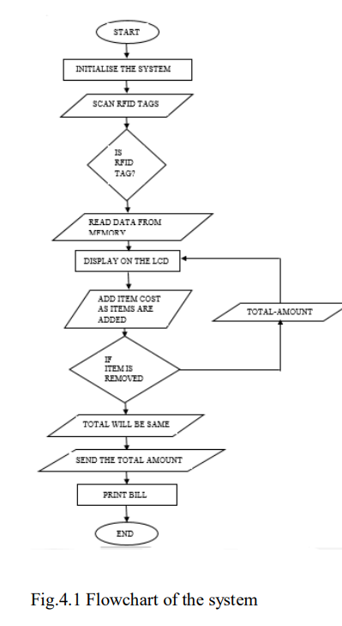
METHODOLOGY
6. The RFID Reader emits a low-power radio emission field that is employed to power up the tag therefore to pass on any data that's contained on the chip.
7. An LCD interfaced with Arduino Uno is used to indicate clients the action taken by customer.
8. At the billing Counter, the cashier counts the total number of items and collects cash and the total bill is provided to the customer.

Slide 12
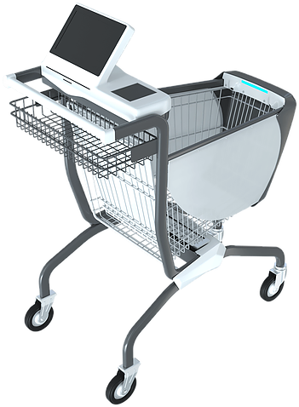
ADVANTAGES
1. No more queue for billing hence real customer satisfaction.
2. Bill calculation at trolley itself.
3. Low chance of traffic and mismanagement.
4. Reduction in support staff.
5. Cost efficient.
6. Weight machine to calculate the product weight.

Slide 13

DISADVANTAGES
1. Materials like metal & liquid can impact signal.
2. Sometimes not as accurate or reliable as barcode scanners.
3. Cost – RFID readers can be 10x more expensive than barcode readers.
4. Implementation can be difficult & time consuming.

Slide 14
FUTURE SCOPE
1. Using a more sophisticated microcontroller.
2. Larger display system
3. GPS to track the product.
4. Internet facility inside the card to browse the offers facility of payment
within the cart by using swapping card can be used to make cart more
advance and to provide consumer a better shopping experience.
5. Increasing the range of our RFID reader will ease the process of product
billing.
6. A billing system can be introduced on an LCD Panel.
7. The stock of all products could be updated in real-time
8. Use of enhanced RFID readers that operate in high frequency which can read multiple tags simultaneously.
9. Mobile application can be developed to avoid smart card and GSM.

Slide 15
Conclusion
Our aim with this project is to reduce the time of billing in long queues so that the customers gets benefited and the same time inventory management becomes so easy.
It can be implemented in shopping malls where there is a large crowd and huge rush into malls.
In the world of Automation, this automatic billing system plays a major role in the upliftment of technology.
This technology will replace the present barcode system which is present being followed.
Hence this technology can help people to make their life’s easy and time saving too.

Slide 16
THANK
YOU

